Slide 1
GAME ORIENTED EDUCATION
A. Petrov, V. Valkanova 13th Workshop ‘Software Engineering Education and Reverse Engineering’ Bansko, Bulgaria 26-31 August 2013

Slide 2
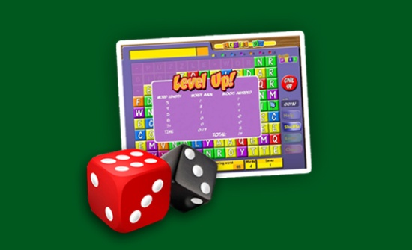
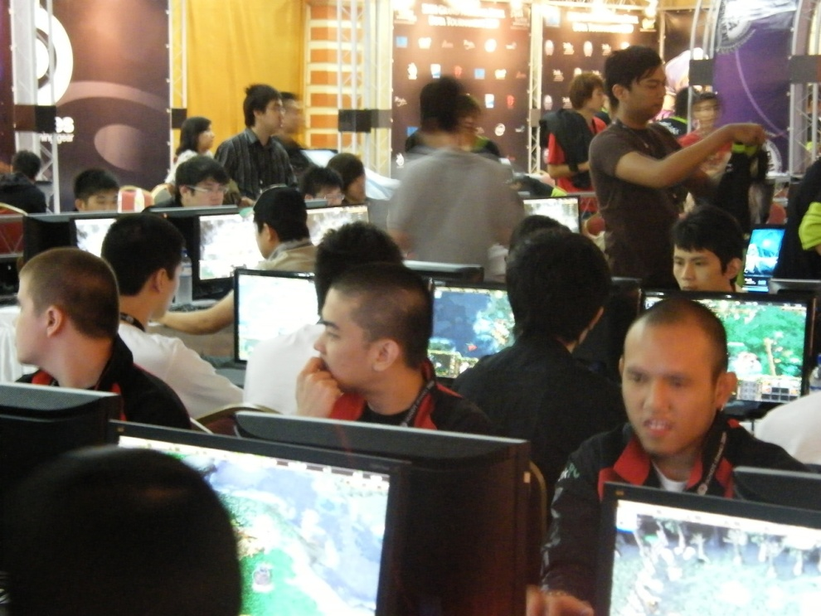
Games
Board Games
Notes:
With the increase and availability of technological devices, there has been a shift in what types of games people play.
Video or electronic gaming has become more widely used than traditional board games

Slide 3
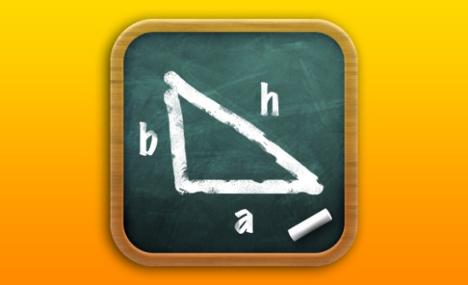
Game Based Learning
Game based learning (GBL) is a type of game play that has defined learning outcomes.
Generally, game based learning is designed to balance subject matter with game play and the ability of the player to retain and apply said subject matter to the real world

Slide 4
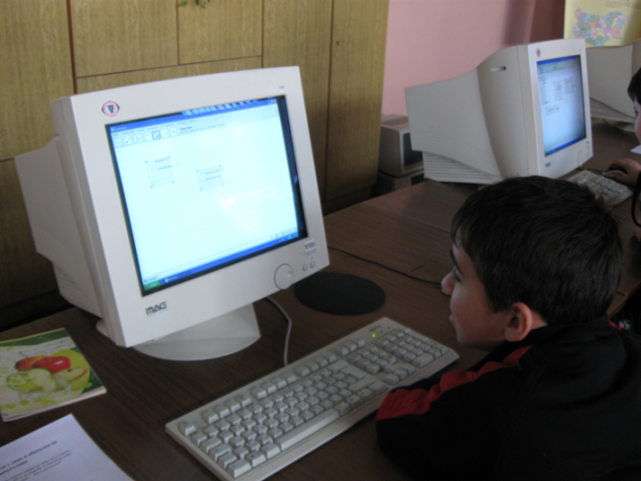
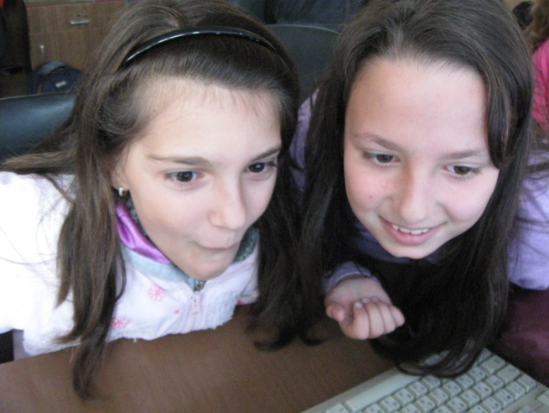
Classic v/s Game Learning

Slide 5
Motivation
Increasing attractiveness and creativity of the students
Simplifying the complex matter
A good way of testing acquired knowledge
A good way of personalized education

Slide 6
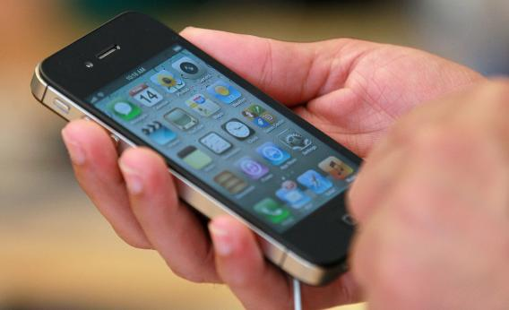
Mobile usage
Notes:
A statistic of the mobile usage shows that most of the people use their devices for playing games.

Slide 7
Games for mobile devices
Notes:
The native approach excels in performance and device access,
but suffers in cost and updates.
The hybrid approach provides a middle ground which, in many
situations, is the best of both worlds, especially if the developer
is targeting multiple operating systems.
The web approach is much
simpler, less expensive and easier to update, but is currently
limited in functionality and cannot achieve the exceptional level
of user experience that can be obtained using native API calls.

Slide 8
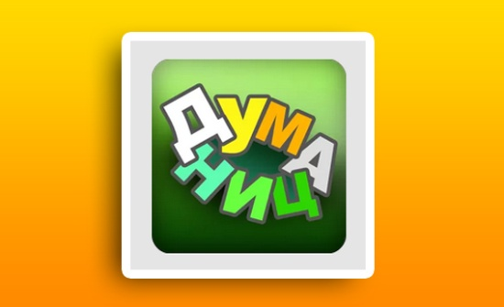
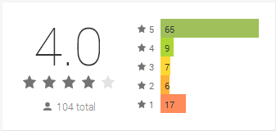
Native App - Dumanica
Downloads 21,391
Notes:
We have made a version of the common game Hangman where the player have a certain number of letter guesses to find out the hidden word. There are synonyms given below the hidden word which are actually the tips for the player. Interesting here is that the player is gaining points for each letter guessed. No matter if he fails or succeed guessing the word he is still earning some points which we think is encouraging them to proceed playing. First I’ve written the game on ActionScript3 but now its rewritten in native Android.

Slide 9
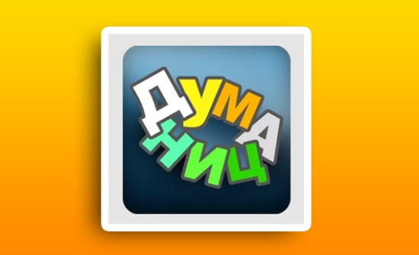
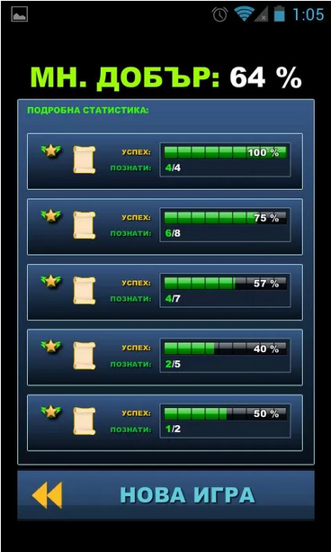
Hybrid App – Dumanica
Notes:
Dumanica – Poetry
Written in Action Script 3 and deployed for android. The application has liquid design so the graphics within will have the same good quality at different screen sizes.
That’s a game where the user has to guess the last word of the line which is replaced with some sort of a star icon.
There is a time for giving the answer which comes in a typical a)b)c)d) option.
After finishing a game round (1 poem) the player gets a success statistic given in percentage.

Slide 10
Web App - Bulls and Cows
Notes:
Simplifying the hard theoretical knowledge.
Due to the fact that combinatorics will be studied since 2013/2014 we decided that it will be easier for the pupils if they play a game connected with that subject and it visually presents them the teaching material.
We have prepared a game prototype of the famous game Bulls and Cows written as a single page web application. What is interesting here is the responsive design. We are planning to make the game multiplayer with match making system. So a player finds an opponent online and plays versus him. Whoever guess first the opponent’s number wins. The win percentage of the player is stored and he will gain achievements as long as he continues playing the game. For example they can be connected with the time used for guessing or the number of guesses made.

Slide 11
Scorm Integration
One of the main purposes is to integrate the games with SCORM.
After playing the games the statistics will be sent to an agent that we call “Teacher’s notebook”, which is an intelligent agent and represents a teacher assistant who will analyze the success rate of the student.

Slide 12
Real time multiplayer
ROOM: Training room
PARTICIPANTS: Player 1 Player 2
Notes:
The Google Play game services provides a multiplayer API to allow you to easily create a game that supports multiple simultaneous players.
The multiplayer API manages the game client network connections and participant status for your game, so you don’t need to handle this explicitly. Room:
A virtual meeting space where games take place.
Players can be invited to join rooms, or be automatically matched into them.
Players that are connected to the same room can exchange game data with each other.
Participant:
Players that can participate in a game. A local player can send invitations to other players from their circles to join a room, or request to be auto-matched to random players.
A player who is sent an invitation will see a notification to accept the game invitation.
If the player accepts the invitation, they are joined to the room.
The state of the participants in a room is managed by Google Play game services and is sent to the game clients.

Slide 13
Achievements in game
Notes:
Achievements can be a great way to increase the users' engagement within the game. Achievements can encourage players to experiment with features they might not normally use, or to approach the game with entirely different play styles. They can also be a fun way for players to compare their progress with each other and engage in light-hearted competition
Here is introduced the Google Play Game Services It’s an API that can easily store player’s data. The example shows how to save an achievement at the player’s statistic.

Slide 14
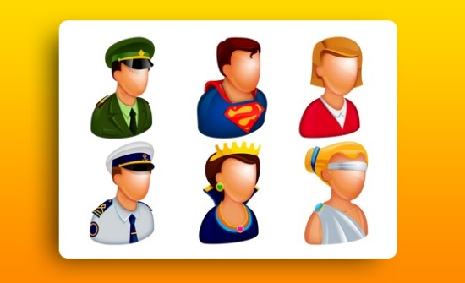
Game Personalization
Notes:
Personalization in game can be easily achieved by creating a custom avatar for each player. Actually the players can build by their own avatars representing their personality in the virtual world. Each player will have an avatar within the game environment. That environment can be changed according to the current player which is also planned as a way of personalization.

Slide 15
Implementation
Secondary school – we plan to use the games in a school positioned in Plovdiv where Veselina Valkanova is teaching.
Other schools – when we have promising results we plan to offer these products in different schools positioned in Bulgaria.
Universities – we will adapt the game’s environment in DeLC. However this will be more complicated as it will be harder to create proper games for students so maybe we will let students to create games by themselves.

Slide 16
Used technologies
JADE
Android API
HTML5 & JS
Google Play Services
SCORM
DeLC portal
3D Modeling Software

Slide 17
Thank you!

